Slide 1

Interactive Climate Data Visualization Tool
Powered by Python, Cartopy & ipyleaflet
Team: Codefleet
Challenge: Visualizing Earth's Climate Data

Slide 2

The Climate Visualization Challenge
Climate datasets are vast and intricate, comprising terabytes of spatial and temporal information from satellites and ground sensors. Traditional static charts and graphs struggle to reveal the full scope of patterns, making it hard for researchers to interpret dynamic environmental changes effectively.
Our audience—climate scientists, data analysts, and stakeholders—requires intuitive tools to visually uncover anomalies, such as heatwaves or ice melt, and track their geographical and seasonal evolution in real time.

Slide 3

Our Innovative Solution
Python-Powered Interactive Tool
Cartopy for Geospatial Mapping
Core engine built in Python to process and render thermal anomalies and geographical trends dynamically, enabling seamless data exploration.
Leverages Cartopy's advanced projections to create precise, customizable maps that accurately represent Earth's curvature and coordinate systems.
ipyleaflet for Real-Time Interaction
NASA GIBS WMS Integration
Integrates ipyleaflet for zoomable, responsive interfaces, allowing users to pan, zoom, and interact with live maps in Jupyter environments.
Pulls high-resolution data from NASA's Global Imagery Browse Services via Web Map Service, ensuring authoritative and up-to-date global climate visualizations.

Slide 4
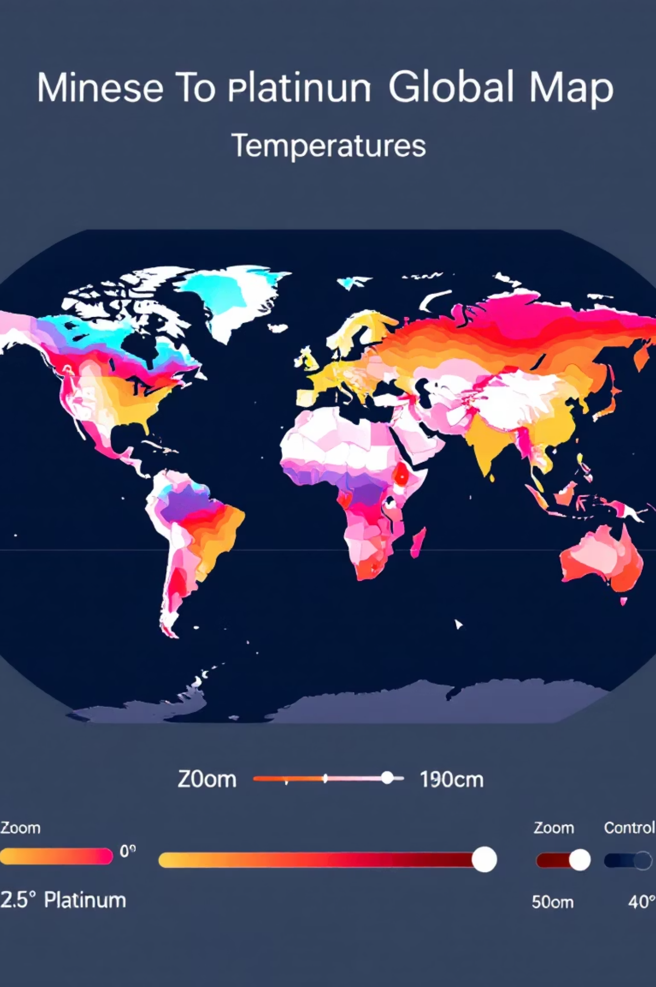




Key Features Overview
Interactive Global Map View
Pan and zoom across the world to explore climate data at any scale, from global overviews to regional details.
Real-Time NASA WMS Data
Streams live imagery and analytics directly from NASA's servers, delivering current and historical climate metrics without delays.
Layer Toggling for Temperatures
Switch between land surface and sea surface temperature layers to analyze specific environmental variables side by side.
Time-Series Anomaly Visualization
Animate temporal data to observe anomaly trends over months or years, highlighting shifts like rising global averages.

Slide 5
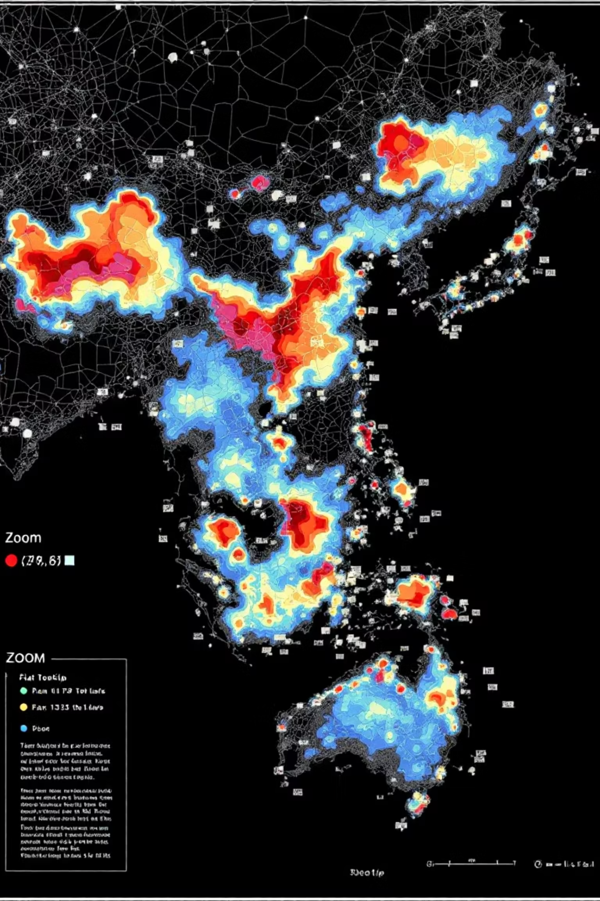
Live Demo Preview
Experience the tool in action: Launch the interface to view a global map overlaid with color-coded thermal anomalies, where warm areas glow in reds and cool zones in blues. Zoom into hotspots like the Arctic or Pacific to reveal detailed overlays, and hover for tooltips delivering precise anomaly values, timestamps, and metadata—empowering instant insights for data-driven decisions.

Slide 6

Transformative Impact
Accessible
Visual
Turns abstract numbers into compelling spatial stories.
Democratizes complex data for non-experts.
Actionable
This tool equips climate researchers, educators, and policymakers with intuitive visuals to foster data-driven awareness and promote proactive climate responsibility, ultimately accelerating solutions to global environmental challenges.
Enables targeted research and policy formulation.

Slide 7




Meet the Team & Future Roadmap
Codefleet Team
Lead Developer
Data Scientist
UI/UX Designer
Expert in Python and geospatial libraries, driving the core mapping engine.
Specializes in climate datasets, ensuring accurate NASA integrations.
Focuses on intuitive interfaces for seamless user interactions.
Next Steps
Expand datasets to include CO₂ levels, vegetation indices, and aerosol distributions for comprehensive environmental analysis.
Enhance with AI-driven anomaly predictions and collaborative sharing features.
Public demo available at: Google Drive Hosted Video or YouTube link.

